Slide 1
ALPHA PRESENTATION
DIVYA SHRIVASTAVA, KIRUBEL TADESSE

Slide 2
OBJECTIVE
To develop a visualization tool to analyse the relationship between websites and their performance parameters which affects their ranking

Slide 3
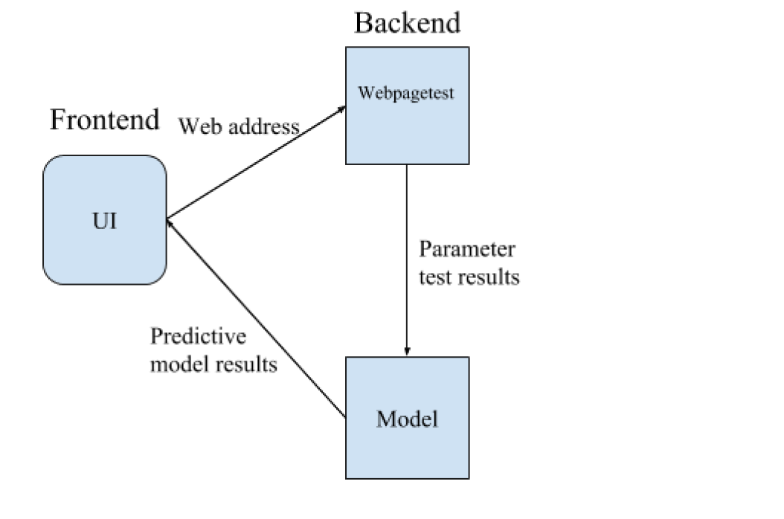
DESIGN

Slide 4
VISUALIZATION TOOL DEMO
https://youtu.be/qSHbC7QEQdI

Slide 5
HISTOGRAM VIEW

Slide 6
DENSITY VIEW

Slide 7
QUESTIONS?

